Slide 1
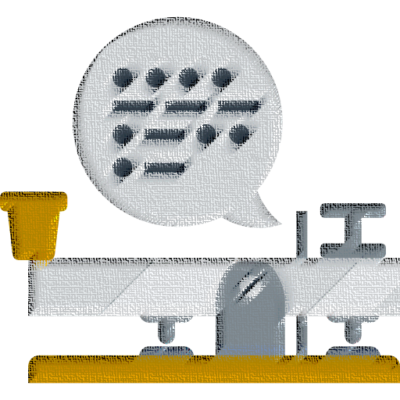



Dr. Babasaheb Ambedkar Technological University, Lonere
E&TC
Morse Code to Text Converter for Paralyzed Individuals
Our project aims to develop an innovative Morse code to text converter specifically designed to assist paralyzed individuals. The device utilizes an embedded system with an eye blinking method, an IR sensor, and a TTS circuit.
Presented by
Rahul Ipte (2130331372503)
Diksha Kharvilkar (2130331372503)

Slide 2
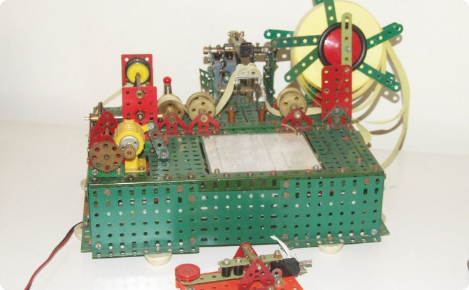
Explanation of Morse Code
Morse Code Basics
Historical Significance
Morse code is a method used in telecommunication to encode text characters as sequences of two different signal durations. It's still relevant today due to its simplicity and effectiveness.
Morse code played a significant role in early telecommunications and is recognized for its crucial contributions in times of need, such as during war and emergency situations.

Slide 3

Overview of Embedded System with IR Sensor and TTS Circuit
Embedded System
IR Sensor
TTS Circuit
The embedded system provides the foundation for the Morse code to text conversion process, enabling efficient signal processing and data transmission.
The IR sensor serves as a pivotal element, detecting
the subtle eye blinking patterns to interpret Morse code input from the user.
The Text-to-Speech (TTS) circuit converts the decoded Morse code into audible speech, ensuring seamless communication of the generated text.

Slide 4

Eye Blinking Method with IR Sensor
1
Signal Detection
The IR sensor captures the user's eye blinking movements, distinguishing between deliberate blinks and casual eye movements.
2
Morse Code Interpretation
The detected blinks are processed to interpret the corresponding Morse code, enabling the translation of the user's input.
3
Real-Time Analysis
The system analyzes the blinking patterns in real time, ensuring accurate decoding of the Morse code signals for text generation.

Slide 5




Detailed Morse Code to Text Conversion Process
Morse Code Input
Users input Morse code through deliberate eye blinking, which is then captured by the IR sensor for further processing.
Signal Processing
The system decodes the input Morse code, converting it to text characters for generating coherent messages.
Text Generation
The converted Morse code is transformed into clear text, allowing the encoded communication to be readily understood.

Slide 6

About TTS system
Text-to-speech or TTS system converts normal text into
Speech. This tech enables the system to speak out the text
in a human voice. There are many examples of Text to
Speech conversions like the announcements at public
transport, the customer care calls, voice assistants in your
smartphones, or the navigation menu of any machine.
You can even find the TTS in Microsoft
Word where you set it to speak out the text written in the
document.

Slide 7

Potential Benefits for Paralyzed Individuals
1
Enhanced Communication
2
Improved Quality of Life
The system enables paralyzed individuals to communicate effectively through Morse code input, promoting independence and connection.
By facilitating communication, the system contributes to an enhanced quality of life, allowing individuals to express their thoughts and needs.
3
Empowerment
Empowering individuals with limited mobility, the system offers a reliable means to engage with their surroundings and loved ones.

Slide 8
Challenges Faced During the Development Process
Technical Complexities
User-Focused Design
The integration of the eye blinking method with accurate Morse code detection presented technical challenges, requiring precise calibration and testing.
Ensuring user comfort and adaptability posed challenges in creating a seamless and non-intrusive system for the target users.
IMG query="user-focused design embedded systems" />
IMG query="technical challenges with embedded systems" />

Slide 9

Future Improvements and Potential Applications
Enhanced Sensor Accuracy
Expandable Communication Modes
Future iterations will focus on refining the IR sensor technology to improve accuracy and responsiveness in detecting eye blinks.
Exploring additional communication modes to complement Morse code, such as gesture-based inputs for versatile interaction.
Integration with Smart Devices
Further applications involve integration with smart devices and IoT platforms, enhancing accessibility and connectivity for users.

Slide 10

Conclusion and Final Thoughts
The Morse code to text converter equipped with the eye blinking method and IR sensor offers a transformative solution for paralyzed individuals, fostering enhanced communication and autonomy. As the technology advances, the potential for broader applications and continued advancements in assistive devices becomes increasingly promising.

Slide 11

Demonstration of the System in Action
We will provide a visual demonstration to showcase the seamless functionality of the Morse code to text conversion system with the integrated eye blinking method and IR sensor.

Slide 12
Thank you

